Slide 1
WELCOME
TO
PROJECT

Slide 2
CAFE
MANAGEMENT
SYSTEM
DONE BY-
Komal Gautam

Slide 3
INTRODUCTION
Café Management System is used for maintaining the details ,Sales ,billing and maintains an inventory for the café. This Project Developed using JAVA.
I Began Creating the café management system with the aid of java and Netbeans .
The topic of my project is a method for cafeteria billing . It is a tool for vendor –side billing . A list of the café products will be available on the dashboard .
Just the count needs to be added ,and the product needs to be enabled .
The bill is provided in the text area , and the bill number is provided at random.
Also, the bill includes the product’s name and quantity.
Finally , there are four buttons : TOTAL ,RECEIPT, RESET and EXIT.

Slide 4
FIELDS IN BILLING APP
Buttons:
TOTAL
RESET
RECIPT
EXIT

Slide 5
Procedure to use App:
Frist , we must give how many quantities we need On products.
Then we need to click on the Check box
Then it will automatically add in the Cost of products.
If the user gives any wrong Input then it will Automatically show remarks For That
If The User tries Before all the Step The total and Receipt buttons are not Work.

Slide 6
Summary
The Topic of my Project is Café Management System . Which Contains all type of Calculations for billing.it is a tool for vendor-slid Billing . A List of the Café Drinks and Cake types is also in the front View
After Entering the quantity we must have to enable the check box for that Product
Then it will automatically get added to our count .
The bill will provide in the Text Area ,for the user’s Understanding
All bills contain unique random numbers for reference .
Finally , there are four buttons :TOTAL , RECEIPT, RESET, EXIT.

Slide 7
Tools Used :
Apache NetBeans
Core Language
Java

Slide 8
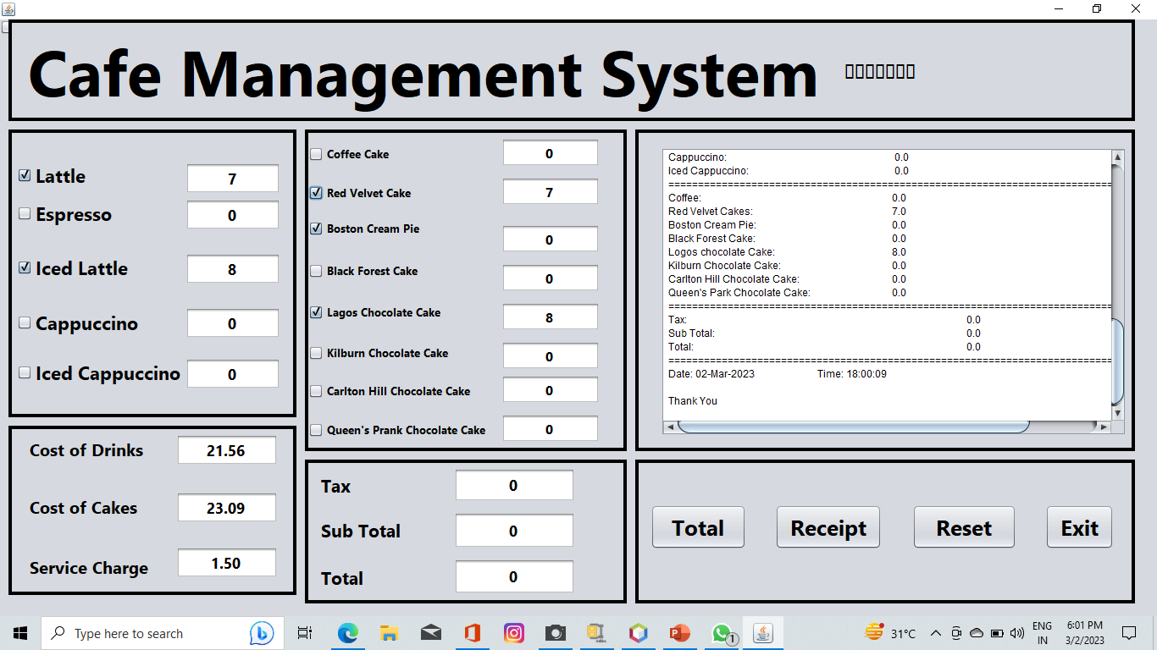
Front View of Billing App:

Slide 9
THANK YOU

